Slide 1
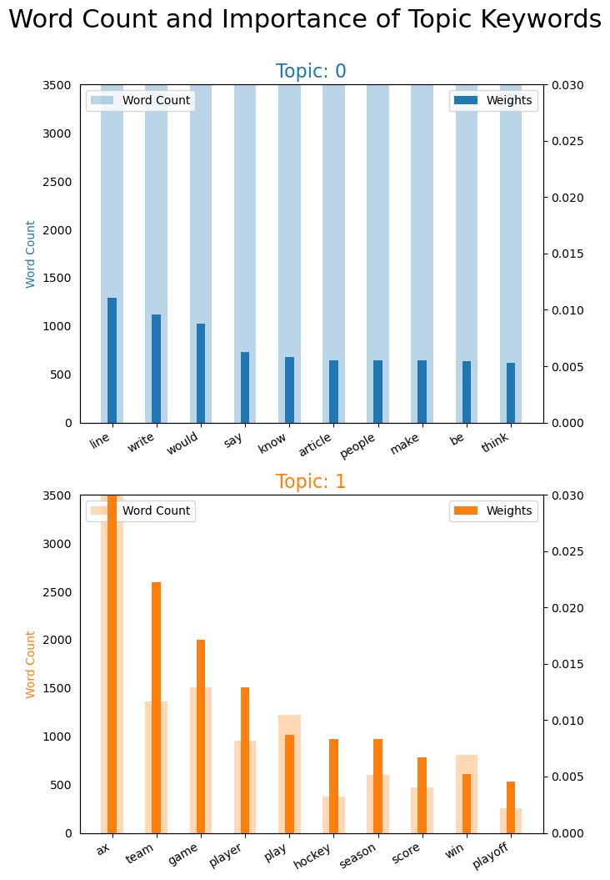
TOPIC MODELING
Independent Study
Workership
Priya Padhiyar

Slide 2
Contents
Introduction to Topic Modeling
1
Demo in Python – LDA model
2
Business Requirement - Workerhsip
3

Slide 3
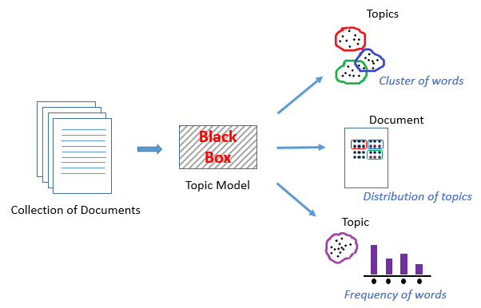
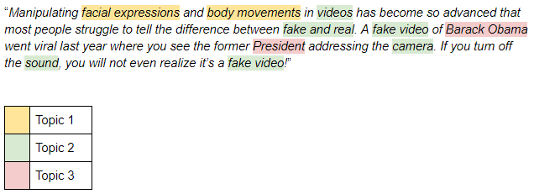
Introduction
What is topic modeling?
As more information becomes available, it becomes more difficult to find and discover what we need.
We need tools to help us organize, search and understand these vast amount of information.
Topic modeling provides methods for automatically organizing, understanding, searching, and summarizing large electronic archives:
Discover the hidden themes(Topics) in the collection
Annotate the documents according to these themes
Use annotations to organize, summarize, search, and form predictions

Slide 4
Project Flowchart:
Import
Packages
Dataset
Data Preprocess
LDA Modeling
Create the corpus after data preprocessing
Using Regex remove Email id & single quotes
Tokenize the text
Create Bigrams & trigrams
Remove Stop words & Lemmatize
Run the LDA model choosing num_of_topics as 2
Visualization
Visualize the Topics using PyLDAvis
Get the infamous word cloud visual of Topics
Multiple other visuals like getting the main topic in each document etc
Run model for Optimal k
Instead of manually trying different values of k to get the best coherence score try running the model for optimal k
Modified code as per Business Requirement
Get the dominant topic for each sentences in the corpus by utilizing the dominant topic of each word that we got by running the LDA model.

Slide 5

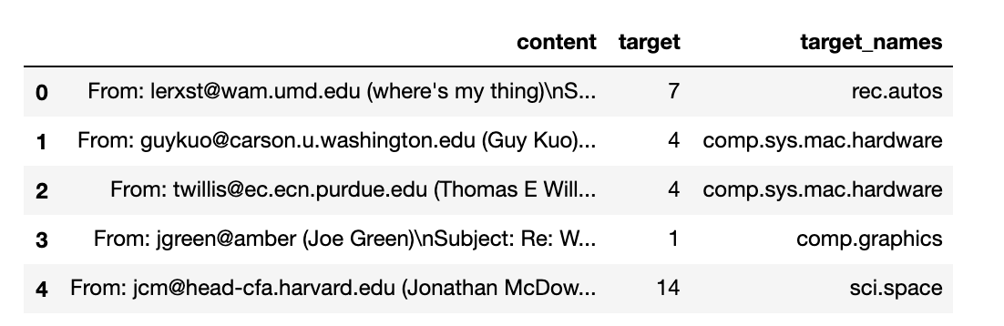


Import the Packages & the Dataset
To get started we first Import a list of packagaes by installing the following:
pip install -U Gensim
pip install spacy
pip install pyLDAvis
The newsgroup dataset after importing

Slide 6
Data Pre-processing Concepts
REGULAR EXPRESSION
STOPWORDS
TOKENIZATION
LEMMATIZATION
BIGRAM/TRIGRAM
CORPUS
A regular expression is a set of characters which is used to find sub strings in each string. for ex. email id from a large unstructured text.
Most common words in a language which are filtered out during the data preprocessing.
E.g.: And, from, with
It splits a piece of text into words, symbols and other meaningful tokens based on its delimiter.
Lemmatization converts the word to its base form.
For example: Running → Run, Eating → Eat.
Grouping of words that frequently occur together.
For example: heavy rain , do or die.
A large and structured set of texts that we get at the end of data preprocessing

Slide 7
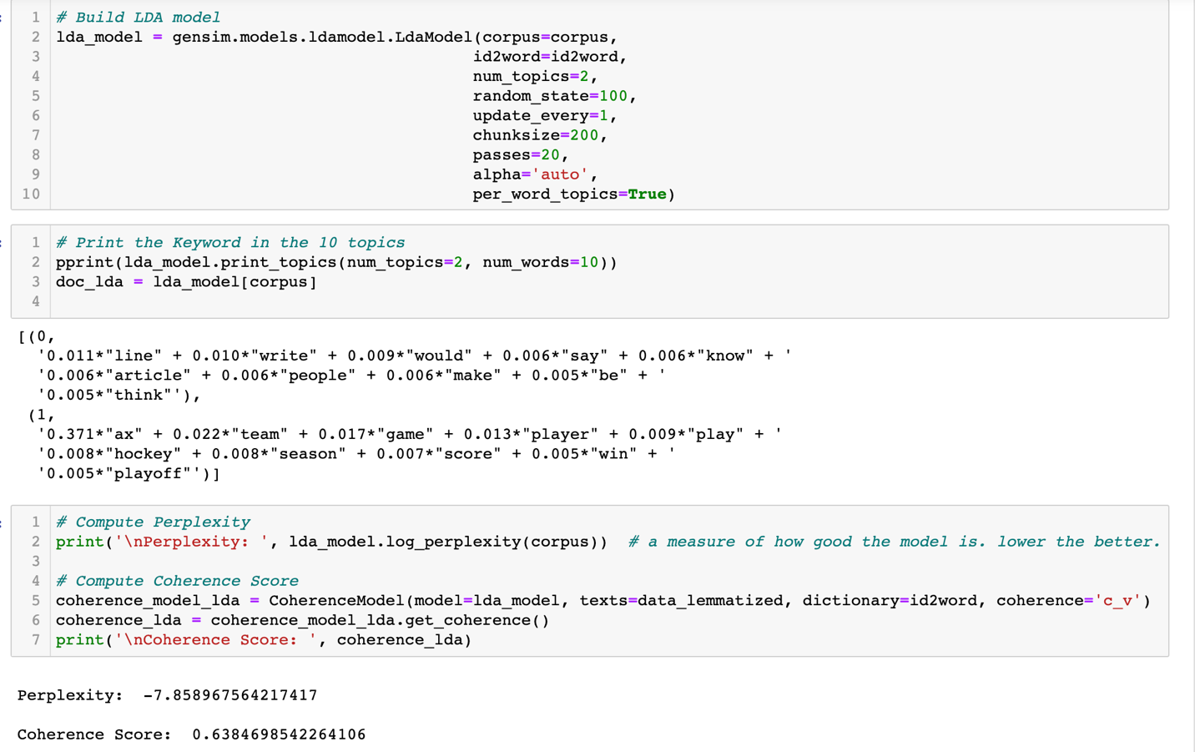
Run the LDA Model
After having the corpus ready we run the LDA model and I have chosen num_topics as 2 as it gives the highest coherence score of 0.63.
The first topic seems to be around ‘writing’ and the second topic is around ‘sports’

Slide 8
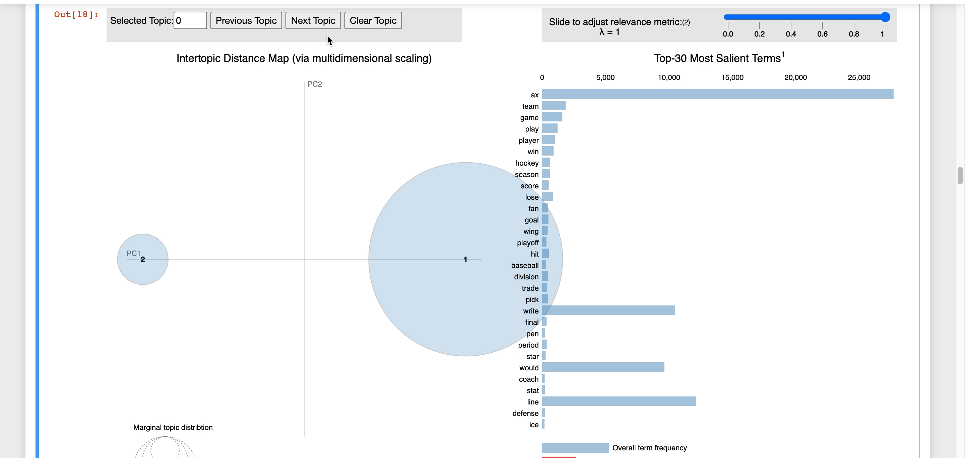

Visualization
PyLDAvis is one of the most well-known visualization of Topic Modeling.
We have two circles representing the 2 topics here. Since the size of the circle 1 is bigger it suggests that it is more dominant topic as compared to topic 2.
Also, the distance between the two circles represent the similarity between the topics. Since there is no overlapping and they are quite distant we can say that both topics are different than one another.
Click to play the video

Slide 9
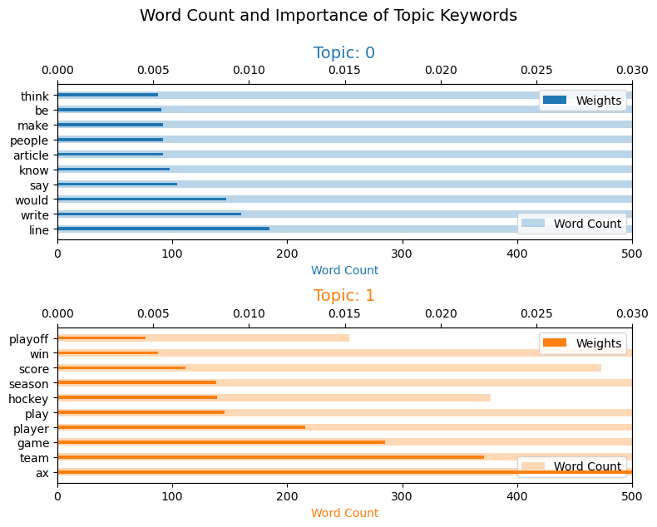
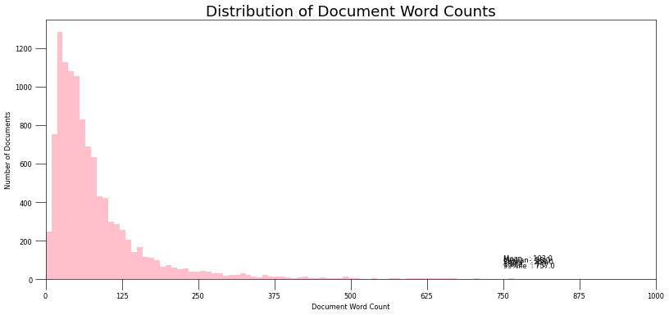
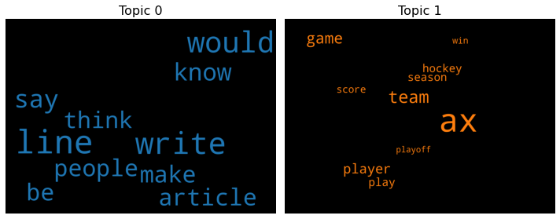

Slide 10
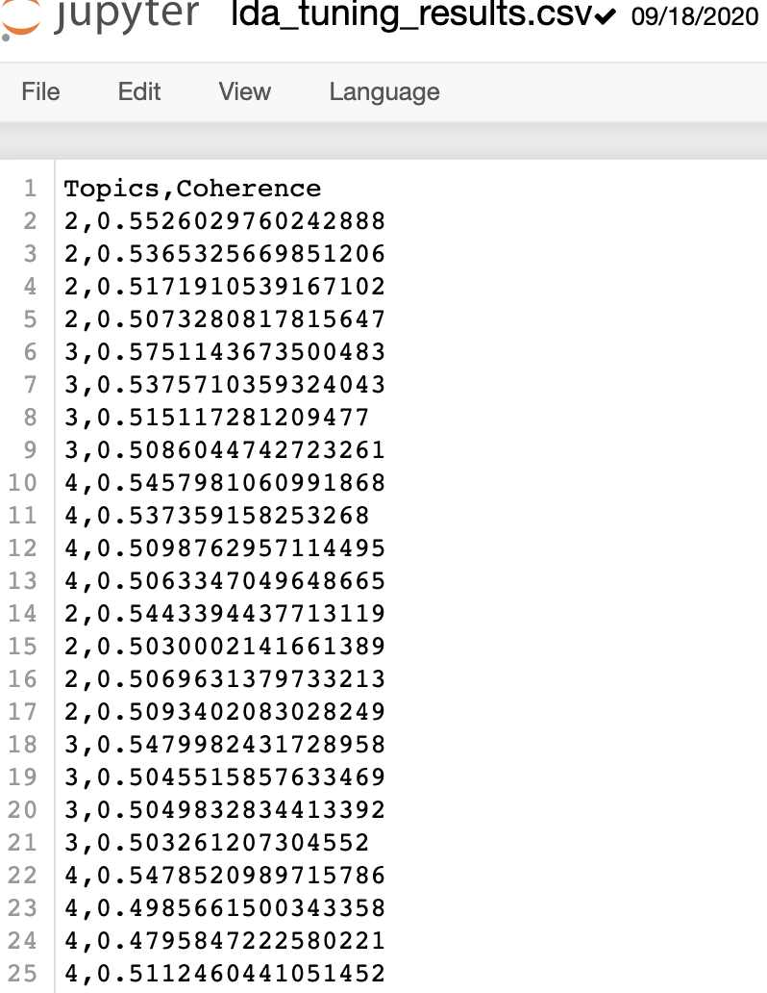
Optimal k
I chose option 3 and after running the code for optimal k the result looks like this:
There is no single best way, and I am not even sure if there are any standard practices for this.
Few ways to find the optimal k are:
Try out different values of k, select the one that has the largest likelihood.
Instead of LDA, see if you can use HDP-LDA
Train multiple LDA models.

Slide 11
WORKERSHIP Business Goal:
Every business has its own requirements which can be achieved by tweaking the results obtained by running the LDA Model.
In case of Workership, the requirement is to get Dominant Topic of each Sentence.

Slide 12
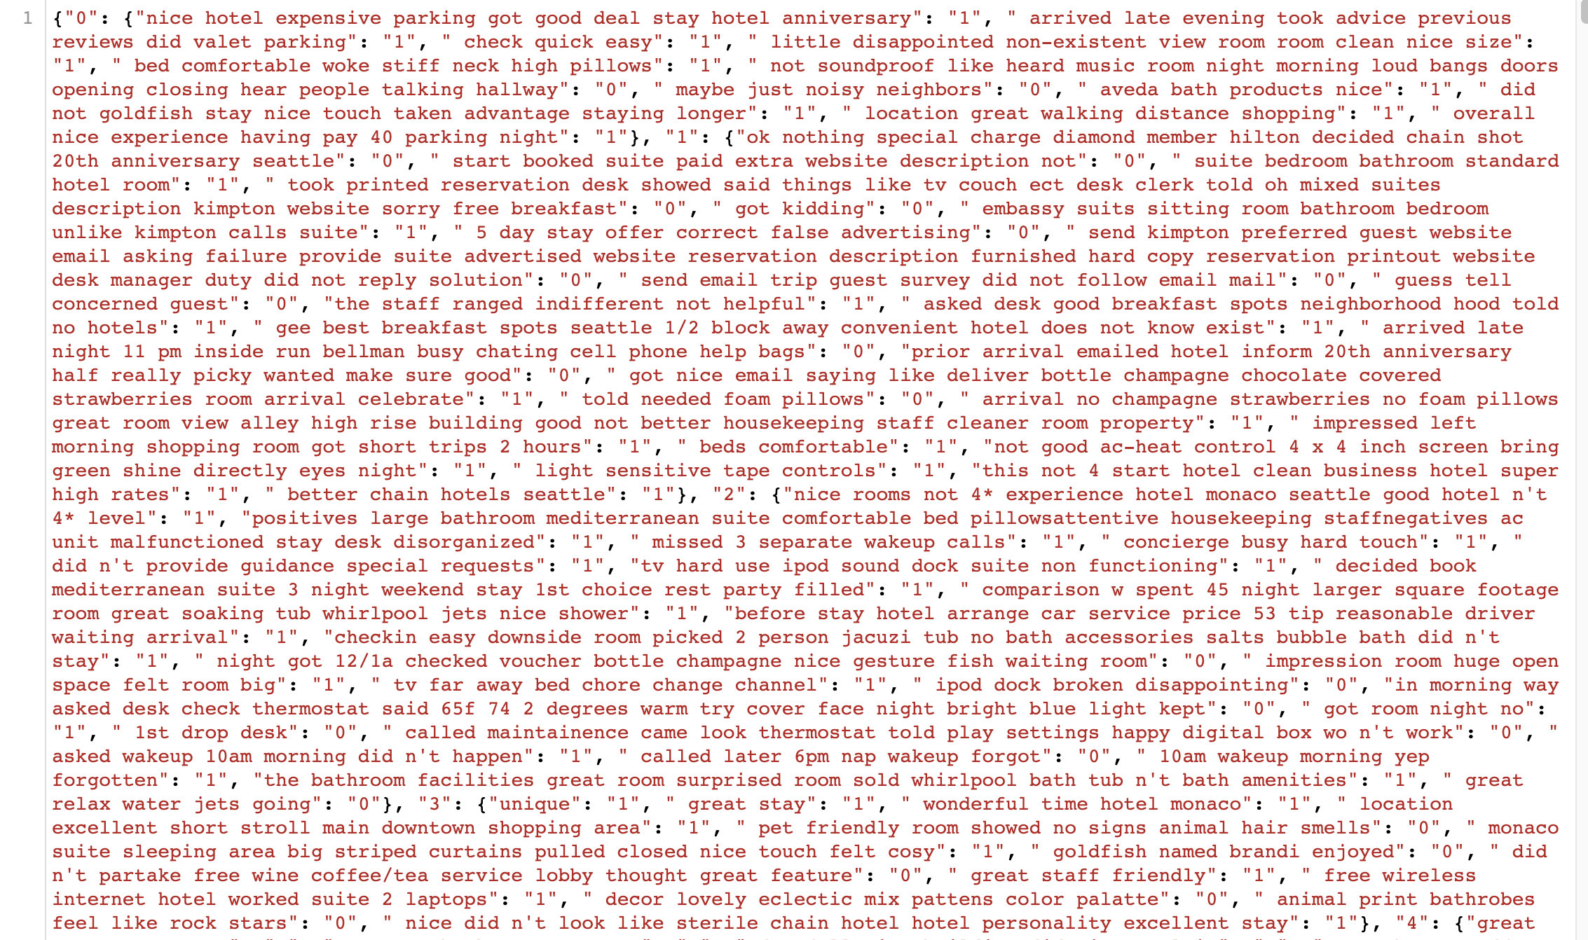
The final json file

Slide 13


Slide 14
References:
https://laptrinhx.com/a-simple-introduction-to-topic-modeling-in-python-1477423910/
https://user.eng.umd.edu/~smiran/LDA.pdf
https://medium.com/analytics-vidhya/regular-expressions-an-excellent-tool-for-text-analysis-or-nlp-d1fa7d666cb9

